Slide 1
Game Theory and Dynamic Optimization
Olivier Rubel, Ph.D.,
Associate Professor of Marketing

Slide 2
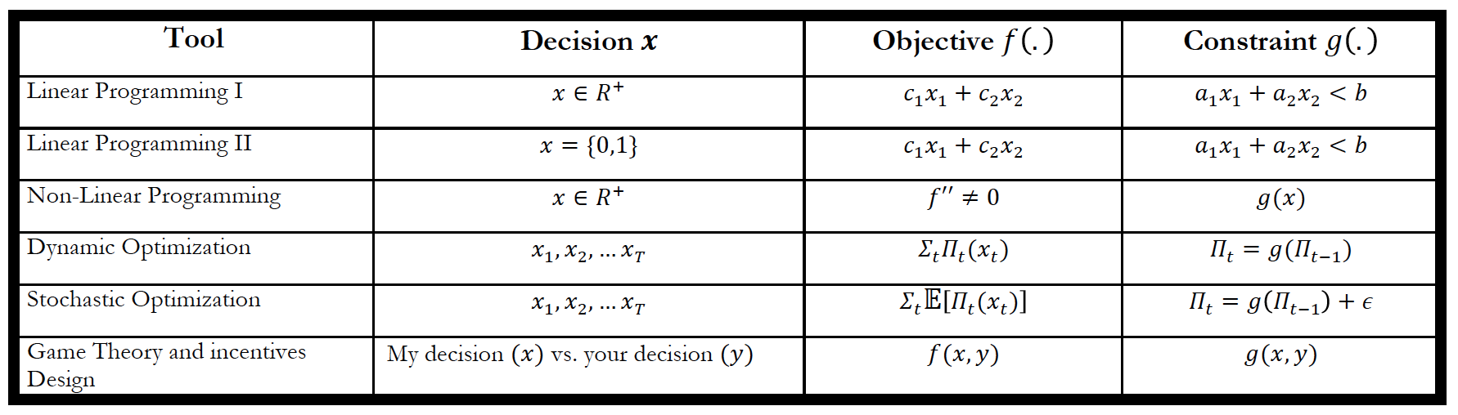
Content
Game Theory: Hierarchical Games
Explanation
In-class game
Dynamic Optimization
Mostly theory
Next week, mostly applications

Slide 3
Non-Cooperative Game Theory (see Reading on Game Theory Models of Pricing)
Definition of a game:
Players, strategies, payoffs
Equilibrium concept:
Nash or Stackelberg

Slide 4
Stackelberg Game
In Stackelberg game, one player (the leader) moves first, while the other (the follower) moves second after observing the action of the leader
Identification of equilibria by backward induction
Start from the end of the game

Slide 5
Mathematical Background

Slide 6
Business Applications
Contract design
Auctions
Incentives design
Supply chain contract
A supply chain is a system of organizations, people, technology, activities, information and resources involved in moving a product (or service) from the supplier to the end customer.

Slide 7
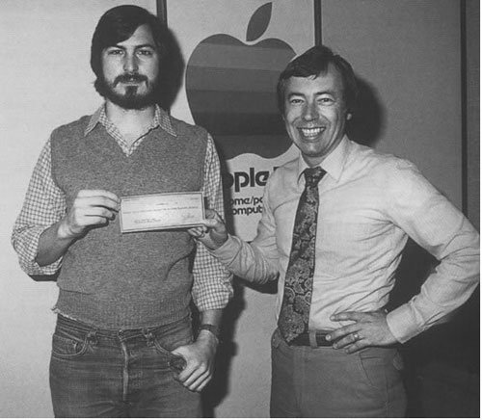
Why is supply design important?
Who are these two guys?
Notes:
http://en.wikipedia.org/wiki/Mike_Markkula
http://en.wikipedia.org/wiki/Don_Valentine

Slide 8
Supply Chain Contracts
Supplier
Retailer
Physical Flow
Financial Flow
A supply chain contract is a set of rules to control the goods/cash flows in the supply chain.
Different types of contracts exist.
Types of contracts:
wholesale price contract
Revenue sharing contracts
Other contracts?

Slide 9
Pricing Game in Channel
Students form supply chains
One Manufacturer and One Retailer
Leader-Follower Framework
Manufacturer announces its wholesale price
Retailer chooses a retail price
w
p_{R}
Manufacturer
Retailer
Consumers

Slide 10
Rules of the Game
The manufacturer’s unit cost is $4 and determines the wholesale price paid by the retailer.
The retailer determines the retail price
Demand is
q = 12 – p + errors
Errors are normally distributed with zero mean and standard deviation of 1
Now you play the game, i.e.,
Manufacturers announce their wholesale prices
Retailers fix the retail prices

Slide 11
Results

Slide 12
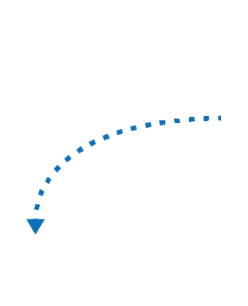


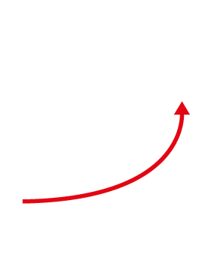

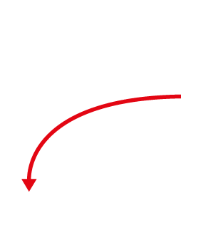

Valuing Free Customers
How should you value a buyer on eBay?
How should you value a LinkedIn user?
How should you value a Twitter user?
Elements of value exchange
PRODUCERS
CONSUMERS
PLATFORM

Slide 13
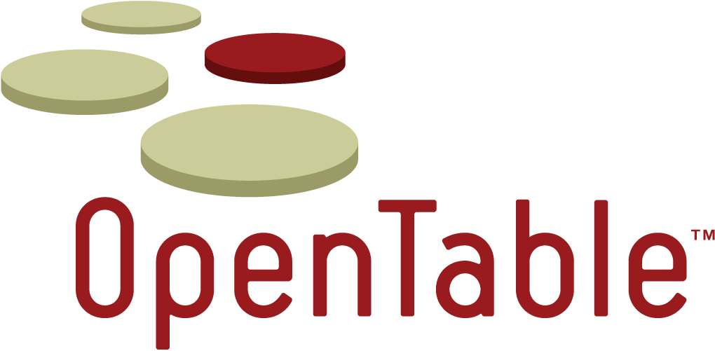
Open Table
Founded in 1998
IPO May 2009
Acquired June 2014

Slide 14
What is the business?
OpenTable, Inc. (together with its subsidiaries, “OpenTable” or the “Company”), was incorporated on October 13, 1998, and is a Delaware corporation. The Company provides solutions that form an online network connecting reservation-taking restaurants and people who dine at those restaurants. For restaurant customers, the Company provides a proprietary Electronic Reservation Book (“ERB”) and Connect. The ERB combines proprietary software and computer hardware to deliver a solution that computerizes restaurant host-stand operations and replaces traditional pen-and-paper reservation books. The ERB streamlines and enhances a number of business-critical functions and processes for restaurants, including reservation management, table management, guest recognition and email marketing. For restaurants that do not require the operational benefits of the ERB, OpenTable offers Connect, a web-based solution that enables participating restaurants to receive reservations from OpenTable’s websites and mobile applications (“apps”) as well as the websites and mobile apps of OpenTable’s partners and restaurant customers. For diners, the Company operates popular restaurant reservation websites and mobile apps. OpenTable’s websites and mobile apps enable diners to find, choose and book tables at restaurants on the OpenTable network, overcoming the inefficiencies associated with the traditional process of reserving by phone.

Slide 15
Key Metrics

Slide 16
Growth of the Platform

Slide 17
Revenues

Slide 18
In %

Slide 19
Dynamic Optimization
Many business decisions involve the control of dynamic systems, i.e., systems that evolve over time.
These systems can be described along the following dimensions
Discrete vs. continuous time
Deterministic vs. Stochastic
Discrete vs. continuous states
One vs. Several players

Slide 20
Examples
Finance analytics: Buying and selling of stocks over time
Pricing analytics: Revenue management
Customer analytics: Managing customer transitions
Advertising analytics: Programmatic advertising
Operations analytics: Inventory management
People Analytics: Managing human capital

Slide 21
Modeling Exercise
Building blocks for model construction
Decisions (Lectures 1 to 4)
Objectives (Lectures 1 to 4)
Constraints (Lectures 1 to 4)
Uncertainty Modeling (Lectures 5 and 6)
State variable and how it evolves
State variables
What you are trying to control because it affects payoffs
“summary” all necessary information to make decisions

Slide 22
Example

Slide 23
Attribution

Slide 24
Building Blocks: Continuous Time

Slide 25
Building Blocks: Discrete Time

Slide 26
Optimal Dynamic Control
What is the “policy” that maximizes the objective function?
What is the resulting “maximized state trajectory” ?
What is the value function?
Value function example:
Maximized sum of all discounted cash flows

Slide 27
Dynamic Decision Making
Start from the end
Dynamic programming decomposes one dynamic problem into a series of static problems, which are “much easier” to solve.
The goal is to obtained a POLICY

Slide 28
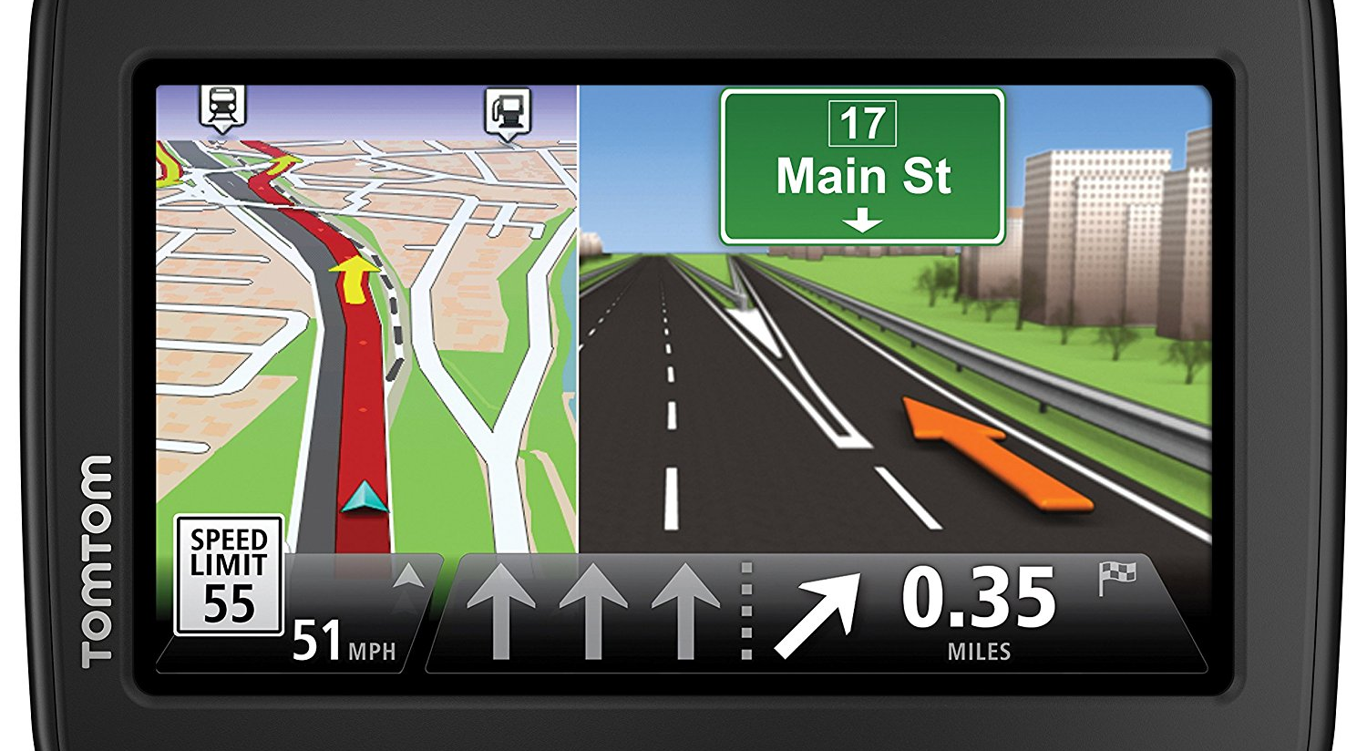
Dynamic Decision Making

Slide 29
Dynamic Programming

Slide 30
Generalizations

Slide 31
What Does it Look Like?

Slide 32
Valuing Free Customers
How much should you value a buyer on eBay?
How much should you value a LinkedIn user?
How much should you value a Twitter user?
Elements of value exchange
PRODUCERS
CONSUMERS
PLATFORM

Slide 33
Key Metrics for OpenTable

Slide 34
Modeling This Problem
At an aggregate level, what are the state variables?
What are the decision variables?
What is the objective function?

Slide 35
Optimal Decision

